Slide 1
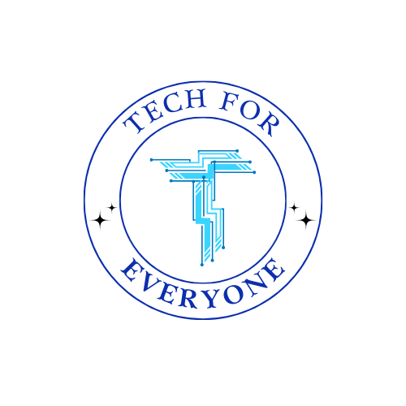
SPACE TECH SERIES
Mae C. Jemison
Engineer, Doctor, and Astronaut
A Space Tech lesson • Upper Elementary
techsheets.dev
Notes:
Welcome the class to today's Space Tech lesson on Mae C. Jemison (astronautics, engineering & medicine in space). Say: "Today we're going to meet Mae C. Jemison, Engineer, Doctor, and Astronaut, and find out how their work helped us explore space." Point out that everyone has a companion worksheet to complete as we go.

Slide 2
Meet Mae C. Jemison
Mae Jemison grew up in Chicago and loved science from the time she was a little girl. She read books about space and dreamed of traveling among the stars. When she was only 16 years old, she started college at Stanford University, where she earned a degree in chemical engineering.
Mae did not stop there. She went on to medical school and became a doctor. She even worked as a doctor in West Africa to help people who were sick. But she never forgot her dream of space.
techsheets.dev • Space Tech Series
Upper Elementary
Notes:
Introduce Mae C. Jemison. Narrate: Mae Jemison grew up in Chicago and loved science from the time she was a little girl. She read books about space and dreamed of traveling among the stars. When she was only 16 years old, she started college at Stanford University, where she earned a degree in chemical engineering. Mae did not stop there. She went on to medical school and became a doctor. She even worked as a doctor in West Africa to help people who were sick. But she never forgot her dream of space. Ask students what they already know about astronautics, engineering & medicine in space.

Slide 3
The Big Idea
In 1987, NASA chose Mae to become an astronaut. On September 12, 1992, she flew into space on the Space Shuttle Endeavour. This made her the first Black woman ever to travel in space. While she orbited Earth, she ran science experiments to learn how bones and living cells change without gravity.
techsheets.dev • Space Tech Series
Upper Elementary
Notes:
Continue the story: In 1987, NASA chose Mae to become an astronaut. On September 12, 1992, she flew into space on the Space Shuttle Endeavour. This made her the first Black woman ever to travel in space. While she orbited Earth, she ran science experiments to learn how bones and living cells change without gravity. Emphasize why this was a breakthrough in space technology.

Slide 4
Space Words to Know
engineer — a person who uses science and math to design and build things
orbit — to travel around and around a planet, like the Moon does
gravity — the pull that keeps things on the ground and holds us to Earth
techsheets.dev • Space Tech Series
Upper Elementary
Notes:
Review key vocabulary before reading: engineer means a person who uses science and math to design and build things; orbit means to travel around and around a planet, like the Moon does; gravity means the pull that keeps things on the ground and holds us to Earth.

Slide 5
Read & Explore
Read the passage on your Space Tech worksheet.
Underline one fact that surprises you.
Get ready to discuss the questions.
techsheets.dev • Space Tech Series
Upper Elementary
Notes:
Have students read the worksheet passage independently or in pairs (about 5 minutes). Circulate and support. Then move into the comprehension discussion.

Slide 6
Let's Discuss
1. What did Mae study in college at Stanford University?
2. Besides being an engineer, what other job did Mae train for?
3. What special first did Mae achieve in 1992?
4. What did Mae do while she was in space?
techsheets.dev • Space Tech Series
Upper Elementary
Notes:
Work through the comprehension questions together. Suggested answers:
1) Chemical engineering.
2) She became a doctor (a physician).
3) She became the first Black woman to travel in space.
4) She ran science experiments to study how bones and cells change without gravity.

Slide 7
Think Deeper
Mae trained as both an engineer and a doctor before going to space. Why might NASA want an astronaut who knows about both machines and the human body?
techsheets.dev • Space Tech Series
Upper Elementary
Notes:
Open discussion / think-pair-share: "Mae trained as both an engineer and a doctor before going to space. Why might NASA want an astronaut who knows about both machines and the human body?" There is no single right answer — encourage reasoning. Sample response: Sample answer: An astronaut who understands engineering can help run and fix the spacecraft and its equipment, while a doctor understands how the human body reacts to space. Knowing both means Mae could operate science tools and also study how weightlessness affects living things and keep the crew healthy.

Slide 8
STEM Challenge: Counting Orbits
The Space Shuttle Endeavour circled all the way around Earth about 16 times each day. Mae's mission lasted about 8 days in space.
Step 1: About how many orbits did Endeavour make in 2 days? (16 x 2)
Step 2: About how many orbits did it make in all 8 days? (16 x 8)
Step 3: The real mission made 126 orbits. How many more is your estimate than the real number? (128 - 126)
techsheets.dev • Space Tech Series
Upper Elementary
Notes:
Guide the Counting Orbits activity on the worksheet. Setup: The Space Shuttle Endeavour circled all the way around Earth about 16 times each day. Mae's mission lasted about 8 days in space.
Answers:
Step 1: 32 orbits
Step 2: 128 orbits
Step 3: 2 orbits

Slide 9
Why It Matters
Mae C. Jemison helped shape astronautics, engineering & medicine in space.
Space technology grows from bold ideas, math, and persistence.
Complete and turn in your Space Tech worksheet.
techsheets.dev • Space Tech Series
Upper Elementary
Notes:
Summarize the lesson's big takeaway and connect Mae C. Jemison's work to today's space exploration. Congratulate students and collect worksheets.

